Slide 1
Bivariate Regression, Part 2
SSI II
February 14, 2019

Slide 2
Previously…
The regression line
Residuals

Slide 3
Essential Questions
How do we decide how well the model fits?
What do the F-statistic and the associated hypothesis test tell us?
How can we do regression “by hand”?
How does sample size matter?

Slide 4
Goodness-of-Fit
How well does the estimated model fit/explain the data?
We use the sum of squared errors from the sample regression estimates to compute two measures of goodness-of-fit
Root mean square error
R-squared

Slide 5
Root Mean Square Error
The average distance of the observations from the regression line
Like the standard deviation or standard error
Measured in units of Y
Slightly different than the Residual Standard Error, which has the model’s degrees of freedom in the denominator

Slide 6
R-squared
What proportion of the variation in Y is explained by X?
RSS = Residual sum of squares (variance of residuals)
MSS = Model sum of squares (variance of sample regression)
TSS = Total sum of squares (variance of Y)

Slide 7
Basic Idea of R²

Slide 8
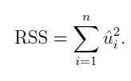
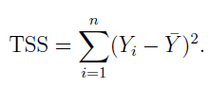
RSS and TSS
RSS – Residual Sum of Squares
The residual variation in Y
Area ‘a’ that is not accounted for by X
TSS – Total Sum of Squares
The total variation in Y
Area ‘a’ and ‘b’ in the Venn diagram

Slide 9
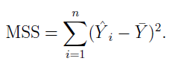
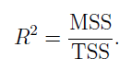
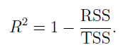
RSS, TSS, MSS, and Goodness of Fit
MSS – the Model Sum of Squares
The other half of the TSS that is not the RSS
The variation in Y accounted for by the model
Since MSS is the variation accounted for by the model, we can use this as a proportion of the total variation to get R²

Slide 10
Using Cost to Predict Debt

Slide 11
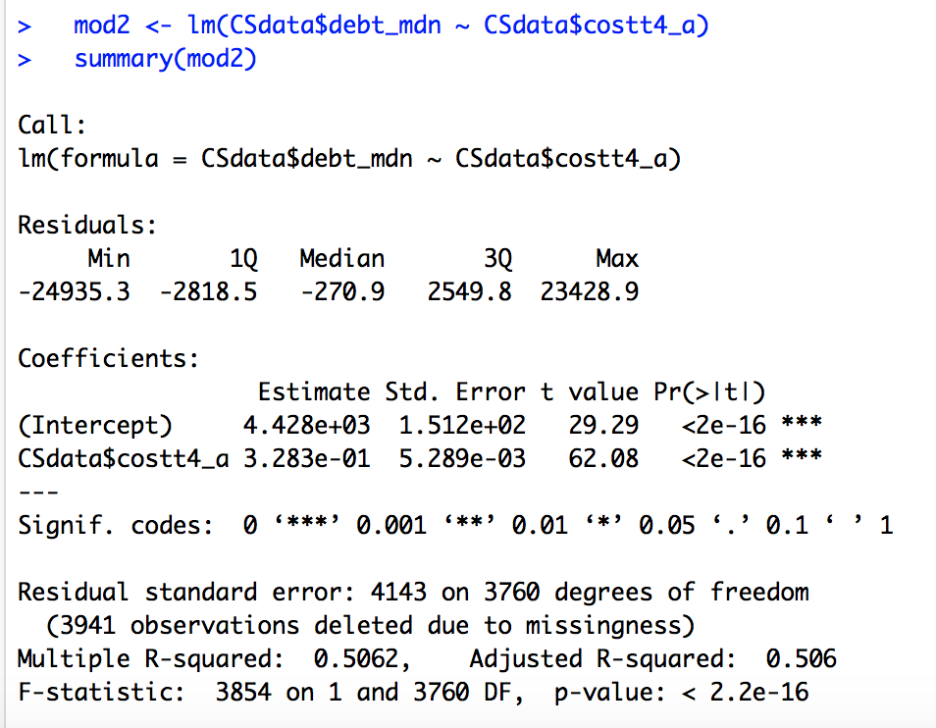
Regression Results
RSE
R-squared

Slide 12
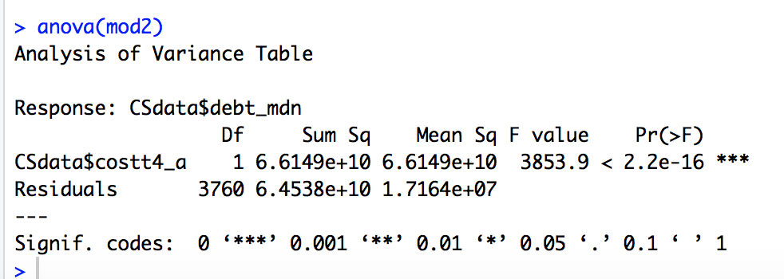
Regression Results
MSS
RSS
TSS = MSS + RSS = 66,149,000,000 + 64,538,000,000
TSS = 130,687,000,000

Slide 13
Cost and Debt

Slide 14
Interpreting Goodness-of-Fit
R-squared
The model/X explains (R²*100)% of the variance of Y.
“The model” always works; “X” only works in bivariate regression
The model/total cost of a school explains 50.62% of the variance of its median student debt.

Slide 15
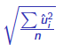
Interpreting Goodness-of-Fit
Root MSE -
On average, the observations are above or below the regression line by RMSE units.
On average, the observations are above or below the regression line by $4,143.

Slide 16
Mean Squares
The “Mean Sq” column in the ANOVA output
The sum of squares divided by its degrees of freedom

Slide 17
Regression Results
MMS
RMS

Slide 18
Mean Squares
MMS=MSS/df= 66,149,000,000/1=66,149,000,000
RMS=RSS/df=64,538,000,000/3760 =17,174,464.8
TMS=TSS/df=130,687,000,000/3761 =34,748,148.7
Notes:
The degrees of freedom for TMS is the df for the model plus the df for the residuals; it is also N-1

Slide 19
The intercept-only model
The predicted values for all of the observations is the mean of Y

Slide 20
F-statistic and F-test
Is the model as a whole significant?
Is your model significantly better than a model with no predictors (an intercept-only model)?
H₀: The fit of the intercept-only model and your model are equal.
H_{A}: The fit of the intercept-only is significantly reduced compared to your model.

Slide 21
F-statistic
F=MMS/RMS
Mean variation explained by the model, divided by the mean variation of the residuals
F=66,149,000,000/1,717,4464.8=3,853.86
R gives this to you in both the regular summary and the ANOVA output

Slide 22
P-value for F
A low p-value (p<.05) means you can reject the null that your model fits the data equally as well as the intercept-only model
A low p-value (p<.05) means that the model as a whole is significant

Slide 23
P-values for F and β-hat
In bivariate regression, the only difference between the intercept-only model and your model is the inclusion of X as a predictor of Y, which leads to the estimate of β-hat
So if the coefficient for the slope is significant, F will be significant and vice versa
In multivariate regression, it is possible (but rare) to have the model be significant and none of the individual IVs be significant

Slide 24
Ex 1: Family Income and Debt

Slide 25
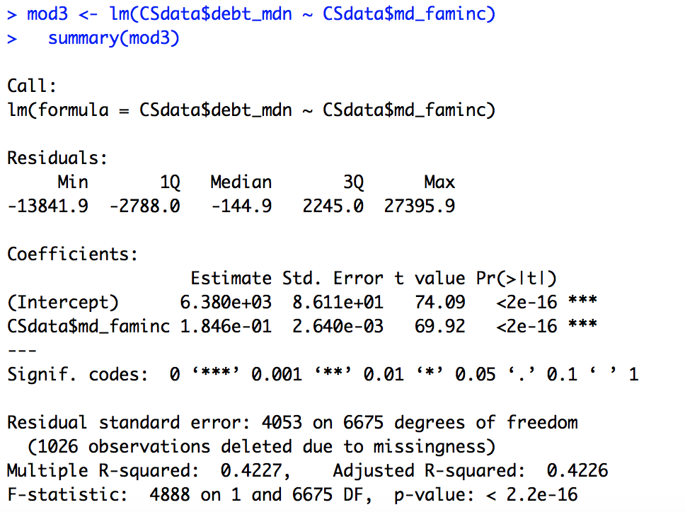
Ex 1: Income and Debt

Slide 26
Ex 1: Income and Debt

Slide 27
Essential Questions
How do we interpret regression results?
What do the F-statistic and the associated hypothesis test tell us?
How can we do regression “by hand”?
How does sample size matter?

Slide 28
Next Time…
Adding more variables – multivariate regression!

